Slide 1
Lecture 11:
Elementary Sorting
Keren Zhu
kerenzhu@cse.cuhk.edu.hk

Slide 2
This lecture will cover
The basic concept of sorting
Review on insertion sorting

Slide 3
Definition
Sorting is the process of:
  Taking a list of objects which could be stored in a linear order
  (a₀, a₁, ..., a_{n – 1})
  e.g., numbers, and returning an reordering
  (a'₀, a'₁, ..., a'_{n – 1})
  such that
  a'₀ ≤ a'₁ ≤ · · · ≤ a'_{n – 1}
The conversion of an Abstract List into an Abstract Sorted List

Slide 4
Definition
Seldom will we sort isolated values
  Usually we will sort a number of records containing a number of fields based on a key:
19991532 | Stevenson | Monica | 3 Glendridge Ave.
19990253 | Redpath | Ruth | 53 Belton Blvd.
19985832 | Kilji | Islam | 37 Masterson Ave.
20003541 | Groskurth | Ken | 12 Marsdale Ave.
19981932 | Carol | Ann | 81 Oakridge Ave.
20003287 | Redpath | David | 5 Glendale Ave.
Numerically by ID Number
Lexicographically by surname, then given name
19981932 | Carol | Ann | 81 Oakridge Ave.
19985832 | Khilji | Islam | 37 Masterson Ave.
19990253 | Redpath | Ruth | 53 Belton Blvd.
19991532 | Stevenson | Monica | 3 Glendridge Ave.
20003287 | Redpath | David | 5 Glendale Ave.
20003541 | Groskurth | Ken | 12 Marsdale Ave.
19981932 | Carol | Ann | 81 Oakridge Ave.
20003541 | Groskurth | Ken | 12 Marsdale Ave.
19985832 | Kilji | Islam | 37 Masterson Ave.
20003287 | Redpath | David | 5 Glendale Ave.
19990253 | Redpath | Ruth | 53 Belton Blvd.
19991532 | Stevenson | Monica | 3 Glendridge Ave.

Slide 5
Definition
In these topics, we will assume that:
  Arrays are to be used for both input and output,
  We will focus on sorting objects and leave the more general case of sorting records based on one or more fields as an implementation detail
In real implementation, comparison-based sorting just need a compare function
  You can have customized compare function for comparing your own structs using std::sort
  std::sort use random access iterator to access the container, so it is not limited to array

Slide 6
In-place sorting
Sorting algorithms may be performed in-place, that is, with the allocation of at most Θ(1) additional memory (e.g., fixed number of local variables)
  Some definitions of in place as using o(n) memory
Other sorting algorithms require the allocation of second array of equal size
  Requires Q(n) additional memory
We will prefer in-place sorting algorithms

Slide 7
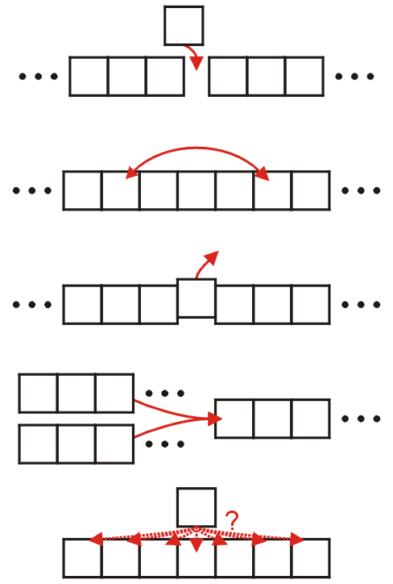
Classifications
The operations of a sorting algorithm are based on the actions performed:
  Insertion
  Exchanging
  Selection
  Merging
  Distribution

Slide 8
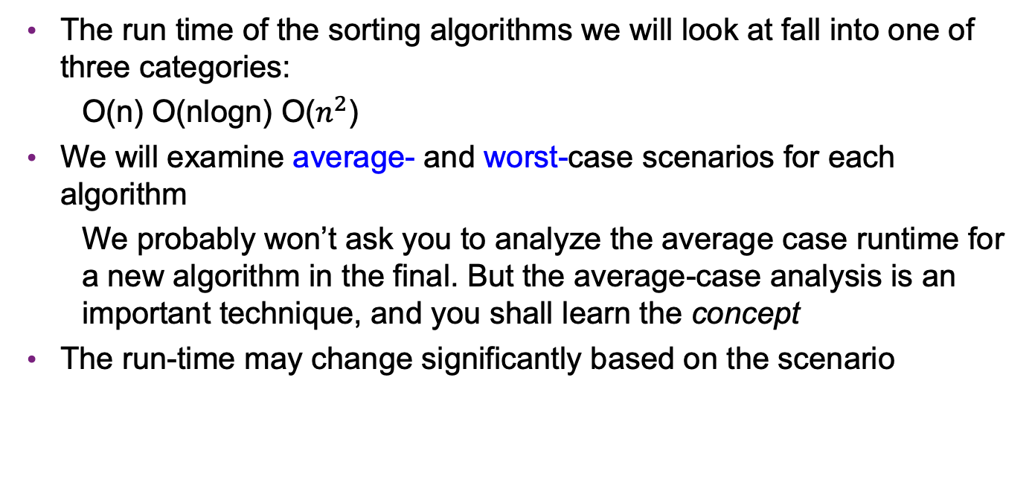
Runtime
The run time of the sorting algorithms we will look at fall into one of three categories:
  O(n) O(nlogn) O($n^{2}$)
We will examine average- and worst-case scenarios for each algorithm
  We probably won’t ask you to analyze the average case runtime for a new algorithm in the final. But the average-case analysis is an important technique, and you shall learn the concept
The run-time may change significantly based on the scenario

Slide 9
Lower-bound Runtime
Any sorting algorithm must examine each entry in the array at least once
  Consequently, all sorting algorithms must be Ω(n)
We will not be able to achieve Θ(n) behavior without additional assumptions
A famous lower-bound for comparison-based sorting is Ω(nlogn)
The proof depends on:
  The number of permutations of n objects is n!,
  A tree with 2^{h} leaf nodes has height at least h,
  Each permutation is a leaf node in a comparison tree, and
  The property that lg(n!) = Θ(n ln(n))
Reference: Donald E. Knuth, The Art of Computer Programming, Volume 3: Sorting and Searching, 2nd Ed., Addison Wesley, 1998, §5.3.1, p.180.

Slide 10
Inversion
Consider the following lists:
1 16 12 26 25 35 33 58 45 42 56 67 83 75 74 86 81 88 99 95
1 17 21 42 24 27 32 35 45 47 57 23 66 69 70 76 87 85 95 99
22 20 81 38 95 84 99 12 79 44 26 87 96 10 48 80 1 31 16 92
To what degree are these three lists unsorted?

Slide 11
Inversions
Given any list of n numbers, there are
pairs of numbers
For example, the list (1, 3, 5, 4, 2, 6) contains the following 15 pairs:
  (1, 3) (1, 5) (1, 4) (1, 2) (1, 6)
  (3, 5) (3, 4) (3, 2) (3, 6)
  (5, 4) (5, 2) (5, 6)
  (4, 2) (4, 6)
  (2, 6)

Slide 12
Inversions
You may note that 11 of these pairs of numbers are in
order:
  (1, 3) (1, 5) (1, 4) (1, 2) (1, 6)
  (3, 5) (3, 4) (3, 2) (3, 6)
  (5, 4) (5, 2) (5, 6)
  (4, 2) (4, 6)
  (2, 6)

Slide 13
Inversions
The remaining four pairs are reversed, or inverted
(1, 3) (1, 5) (1, 4) (1, 2) (1, 6)
  (3, 5) (3, 4) (3, 2) (3, 6)
  (5, 4) (5, 2) (5, 6)
  (4, 2) (4, 6)
  (2, 6)

Slide 14
Inversions
Given a permutation of n elements
a₀, a₁, ..., a_{n – 1}
an inversion is defined as a pair of entries which are reversed
That is, (a_{j}, a_{k}) forms an inversion if
j < k but a_{j} > a_{k}
Ref: Bruno Preiss, Data Structures and Algorithms

Slide 15
Inversions
Therefore, the permutation
1, 3, 5, 4, 2, 6
contains four inversions:
  (3, 2) (5, 4) (5, 2) (4, 2)

Slide 16
Number of Inversions
There are pairs of numbers in any set of n objects
Consequently, each pair contributes to
  the set of ordered pairs, or
  the set of inversions
For a random ordering, we would expect approximately half of all pairs, or
, inversions

Slide 17

Review on insertion sorting
In Lecture 3, we talked about insert sort
For every element, insert it to the right place and move the other elements

Slide 18
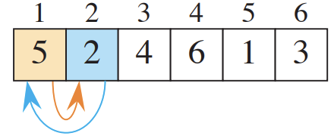
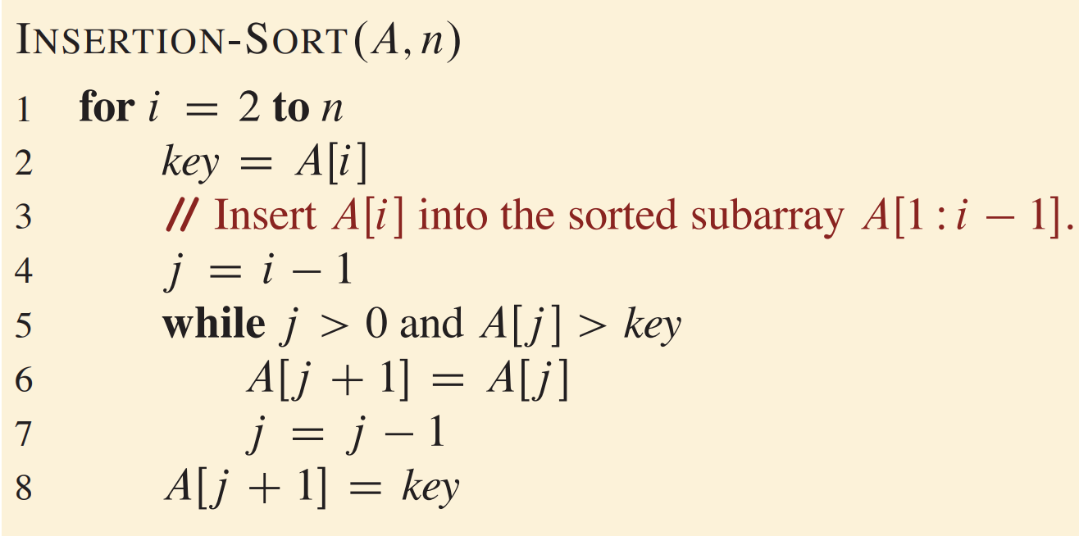
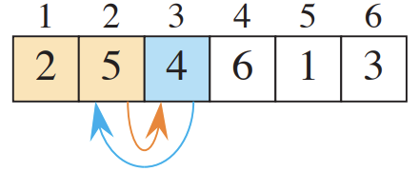
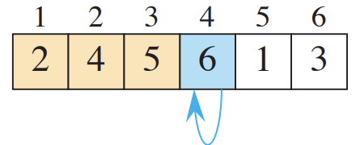
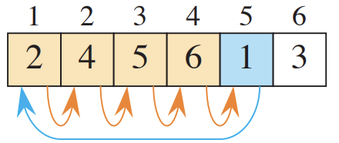
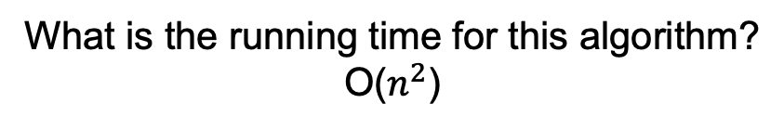
Pseudocode for insertion sort
What is the running time for this algorithm?
O($n^{2}$)

Slide 19
Average case
We may break the loop earlier
Observation: Each time we perform a swap, we remove an inversion
The loop is run only as often as there are inversions
If the number of inversions is d, the runtime is Θ(n + d)

Slide 20
Consequences of Our Analysis
A random list will have d = O(n²) inversions
  The average random list has d = Θ(n²) inversions
  Insertion sort, however, will run in Θ(n) time whenever d = O(n)
Other benefits:
  The algorithm is easy to implement
  Even in the worst case, the algorithm is fast for small problems
  Considering these run times,
  it appears to be approximately
  10 instructions per inversion
Size | Approximate Time (ns)
8 | 175
16 | 750
32 | 2700
64 | 8000

Slide 21
Consequences of Our Analysis
Unfortunately, it is not very useful in general:
  Sorting a random list of size 2²³ ≈ 8 000 000 would require approximately one day
Doubling the size of the list quadruples the required run time
  An optimized quick sort requires less than 4 s on a list of the above size

Slide 22
Consequences of Our Analysis
The following table summarizes the run-times of insertion sort
Case | Run Time | Comments
Worst | Θ(n²) | Reverse sorted
Average | O(d + n) | Slow if d = ω(n)
Best | Θ(n) | Very few inversions: d = O(n)
Auxiliary Memory: O(1)

